Slide 1

3C4A NCAA Update
Andy Cardamone March 26, 2019 Concord, CA
Notes:
This is a title slide.
Type in the presentation’s title in all caps where indicated above. Then, type in the subhead. If you do not need a subhead, this section may be deleted.
If you have the Helvetica font family loaded on your computer, it will appear throughout the templates. If you do not have that font family loaded on your computer, the templates will default to the Ariel font. Either are acceptable for use in this template.
Select and use only one of the introductory photo slides (one of many is pictured above). Do not make any image or design edits to this slide.
When selecting an introductory photo slide, ask yourself: Does the photo reflect your presentation content appropriately? For example, don’t use an athletic photo for a presentation about academic opportunities. Select a campus-based or academic image instead. Or, use the logo-only introductory slide included in this template.

Slide 2
Division I Legislation
Case Studies & Update
Notes:
This is a divider slide, intended to go between presentation topic sections. It can also be used to identify your department/group name as the presenter.
If you opt to use this slide as a divider slide, the master title text box area is where you will type in the presentation’s name and the subhead text box is where you will type in the presentation’s section name, department/group name or other content.

Slide 3
2-4 Transfers – Competition Requirements
Qualifier
Nonqualifier / Academic Redshirt
Graduate from two-year college.
Minimum of three full-time terms attended.
Minimum 48-semester or 72- quarter transferable hours.
Six/eight transferable hours English, three/four math, three/four science.
2.500 GPA on transfer credit.
Minimum one full-time term attended.
Average of 12 transferable hours per full-time term.
2.500 transferrable GPA
OR
Meet requirements for a nonqualifier.

Slide 4
2-4 Transfers PE Activity Requirements
Nonqualifier
Qualifier
Limit of two hours of physical education activity coursework.*
Excess hours removed from transfer credit total AND GPA calculation.
*See Physical education/education degree at certifying institution exception.
Academic Redshirt

Slide 5
2-4 Transfers Summer Limits
Academic Redshirt
Nonqualifier
No more than 18/27 hours total.
No more than nine/13.5 hours in the summer prior to transfer.
Effects 48/72 and core-course requirements.

Slide 6
4-2-4
Transfer Requirements
First four-year institution.
Two-year institution.
Certifying four-year institution.
Graduate.
Average of 12 hours per term of attendance at two-year institution.
2.500 GPA.
Only two physical education activity hours.
One calendar year from first four-year institution prior to competition.
Bylaw 14.5.6

Slide 7
Question – Qualifiers Use of Nonqualifer Requirement
Can a football student-athlete who initially enrolled full-time in Fall 2015 fall under the new exception where Qualifiers can be eligible under NQ rules?
Answer: The exception was effective 8/1/17 for certifications of eligibility for fall 2017 and after.
Therefore student-athletes enrolled prior to August 2017 may be certified using the exception.

Slide 8
Question – Transferable Math Requirements
SA is completing a two-year degree which requires statistics.
When SA spoke with a coach, they stated he would need to take a transferrable College Algebra course because the statistics class will not count.
Even though the statistics course is an approved class for UC and Cal State degree purposes, institution stated they will not take it due to NCAA rules.

Slide 9
Transferable Math Requirements
Current Legislation
Statistical modeling of four-year college outcomes from two-year college academic variables indicated a key predictor of academic success at the four-year institution was successful completion of transferable credits in math.
The legislation was therefore written to reflect that research.
Staff has interpreted the legislation to reflect that intent.

Slide 10
Transferable Math Requirements
Past Nine Years
Some improvement to two-year transfer academic performance.
There have been many interpretation requests regarding transferable math.
Institutions with very specific curriculums and academic department differences (e.g., quantitative reasoning degree requirements, split departments of math and statistics) have required some students-athletes to enroll and complete an additional “math” course to satisfy the legislation.

Slide 11
Transferable Math Requirements
New Waiver Directive
NCAA Division I Committee on Academics Subcommittee on Student-Athlete Academics approved a directive change effective for 2019-20 academic year.
Division I member institutions may file waivers via NCAA online system demonstrating documentation of:
Assessment of student-athlete’s transferable courses and their inability to meet the legislative standard;
Transferable quantitative reasoning (or statistics, equivalent institutional math/quantitative reasoning course requirement) coursework; and
That no additional Math or statistics, quantitative reasoning requirements for graduation in the declared degree program remain for the student.

Slide 12
Transferable Math Requirements
Committee Exploration of Proposal
NCAA Division I Committee on Academics Subcommittee on Student-Athlete Academics will explore submitting a legislative proposal that could be effective for 2020-21 academic year.
Will require membership feedback, amendment, etc.

Slide 13
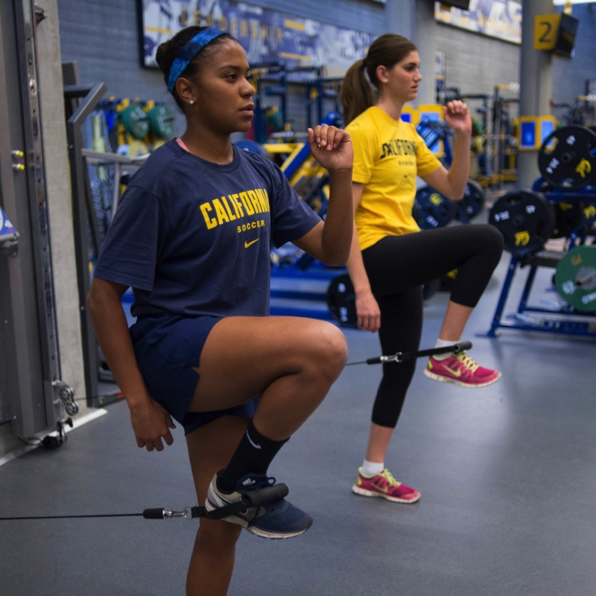


QUESTIONS?
Notes:
This is a content slide that features an opportunity to display three like images. To edit any of the photos, click on the image, then right click on the image. Select “Change Picture” and then browse for the photo you’d like to place. Insert the photo, and size it to the frame provided by holding down the “Shift” key while dragging a corner of the image to the edge of the frame. Holding down the “Shift” key while you drag the image corner will make sure it’s sized proportionately.
Presentation photos may be downloaded from ncaaphotos.com.
Text may be added in the horizontal text box located on the page’s bottom third. Note that the orange triangle will automatically precede new text when you hit the “Enter” key. A black triangle will appear under the orange triangle if a secondary point is needed.

Slide 14


PROPOSAL NO. 2018-43 -- CONTACTS AND EVALUATIONS – TWO YEAR COLLEGE SA – OFF CAMPUS CONTACT DURING FIRST YEAR OF ENROLLMENT – NOT A QUALIFIER
RECRUITING
To permit off-campus contact with a PSA who was not a qualifier and who is in his or her first year of full-time enrollment at a two-year college; further, to specify that such contact may only occur at the SA's educational institution.
Immediate
American Athletic Conference
Notes:
Use this exact format for the first slide.
TITLE: Remove topical area (e.g., playing and practice seasons, recruiting, financial aid) from title and place in blue bar under title.
INTENT: Copy intent (make appropriate edits) into middle text box.
EFFECTIVE DATE: Put effective date in blue bar along bottom.
SPONSOR(s): Put sponsor in dark blue bar along bottom.

Slide 15
CURRENT RULE
No in-person contact, on or off campus, with nonqualifier in first year of enrollment at a two-year institution.
PROPOSAL
In-person contact permitted at two-year institution during nonqualifier's first year of enrollment.
Notes:
Use creative license on the slide to explain what proposal will do in laymen’s terms. Not feeling creative? Use style above.

Slide 16
PROPOSAL NO. 2017- 17 – SEASONS OF COMPETITION – CRITERIA FOR DETERMINING SEASON OF COMPETITION – UP TO FOUR CONTESTS – FOOTBALL
In football, to specify that a student-athlete may participate in up to four contests in a season without using a season of competition.
ATHLETICS ELIGIBILITY
August 1, 2018
Atlantic Coast Conference

Slide 17
CURRENT RULE
If a student-athlete competes for any duration at any time during a season, he or she uses a season of competition.
PROPOSAL
In football, allow SAs to compete in up to four contests without using a season.
Competition can occur at any time during season.

Slide 18
Academic Misconduct
Notes:
This is a divider slide, intended to go between presentation topic sections. It can also be used to identify your department/group name as the presenter.
If you opt to use this slide as a divider slide, the master title text box area is where you will type in the presentation’s name and the subhead text box is where you will type in the presentation’s section name, department/group name or other content.

Slide 19
Transfer Student-Athletes
The NCAA has seen a rise in the amount of academic misconduct involving transfer student-athletes.
Use of online courses in order to gain their eligibility at the certifying institution.
NCAA institutions should think about reviewing the online coursework:
  At an institution other than the one they are attending;
  Completed in the semester before their enrollment (or later) at the certifying institution; and
  It was used to gain their eligibility.
Institutions should think about reviewing the course.
Issues have involved potential academic misconduct, and inducements impermissible person paying for the course (e.g. a coach).

Slide 20
Signs of Potential Academic Misconduct
Miraculous recoveries.
  Student-athlete has consistently performed poorly in class, then manages to score extraordinarily well on subsequent assignments/tests. This is done without corresponding tutoring or other academic assistance.
Lack of knowledge of course materials.
  Particularly in online courses, student-athletes do not know how to sign on to the course page, do not know how many assignments they have, when exams are, yet they have been making progress in the course.

Slide 21
QUESTIONS?
Notes:
This is a content slide that features an opportunity to display three like images. To edit any of the photos, click on the image, then right click on the image. Select “Change Picture” and then browse for the photo you’d like to place. Insert the photo, and size it to the frame provided by holding down the “Shift” key while dragging a corner of the image to the edge of the frame. Holding down the “Shift” key while you drag the image corner will make sure it’s sized proportionately.
Presentation photos may be downloaded from ncaaphotos.com.
Text may be added in the horizontal text box located on the page’s bottom third. Note that the orange triangle will automatically precede new text when you hit the “Enter” key. A black triangle will appear under the orange triangle if a secondary point is needed.

Slide 22
Division II 2-4 Transfers

Slide 23
Qualifier with no four-year attendance and ONLY one full-time semester/quarter at two-year institution | All other qualifiers, partial qualifiers and nonqualifiers | All other qualifiers, partial qualifiers and nonqualifiers
ONLY one full-time semester/quarter | Two full-time semesters/three full-time quarters | Two full-time semesters/three full-time quarters
12 semester or quarter hours of transferable degree credit. | 12-semester or 12-quarter-hours of transferable degree credit per term of attendance: Six- semester/eight-quarter hours of transferable English; Three-semester/four-quarter hours of transferable math; and Three-semester/four-quarter hours of transferable science. | Graduate
Cumulative GPA of 2.200 | Cumulative GPA of 2.200
Limit of two physical education activity credits for credit requirements and GPA. | Limit of two physical education activity credits for credit requirements and GPA.

Slide 24
QUESTIONS?
Notes:
This is a content slide that features an opportunity to display three like images. To edit any of the photos, click on the image, then right click on the image. Select “Change Picture” and then browse for the photo you’d like to place. Insert the photo, and size it to the frame provided by holding down the “Shift” key while dragging a corner of the image to the edge of the frame. Holding down the “Shift” key while you drag the image corner will make sure it’s sized proportionately.
Presentation photos may be downloaded from ncaaphotos.com.
Text may be added in the horizontal text box located on the page’s bottom third. Note that the orange triangle will automatically precede new text when you hit the “Enter” key. A black triangle will appear under the orange triangle if a secondary point is needed.

Slide 25
Eligibility Center Update

Slide 26
Eligibility Center
Step One-Registration
Who?
Any student interested in Division I or Division II
Registration options
Certification Account
$90 Domestic, Canada or US territories
$150 International
Fee waiver eligible?
Previously attended high school must approve electronically
Profile Account
No charge
May be converted to certification account
Member Institutions cannot see or activate

Slide 27
Eligibility Center
Step One-Registration
When?
While in high school or prior to transferring
Certification Account registration required for official visits and IRL activation
The correct enrollment period is important
Should be based on initial DI/DII enrollment
Why?
To establish initial-eligibility academic status if necessary
Students without an initial-eligibility academic decision are considered non-qualifiers for transfer purposes
All students must receive amateurism certification prior to competing at a Division I or Division II institution

Slide 28
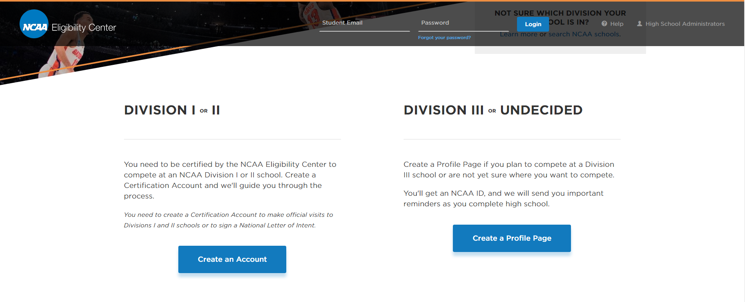
Eligibility Center Step One-Registration

Slide 29
Eligibility Center Step Two-Getting Reviewed
What is needed to get an academic certification?
Paid Certification Account registration
Official transcripts from all secondary schools attended
Proof of graduation
Test scores
Must be taken prior to full-time collegiate enrollment
Submitted electronically using code 9999
Ask for a certification
Students should identify themselves as a 2-4 transfer in need of an academic decision
Push back from NCAA staff?
Be persistent-make sure we know why you are asking.

Slide 30
Eligibility Center Step Two-Getting Reviewed
Timeline once request entered
No specific service standard
Requests accepted anytime
Why might we be unable to move forward?
Missing documents or need clarification
Tasks are assigned
High school or non-traditional program not cleared
NCAA Institution involvement required if…
Post graduate coursework or test scores
Validation of coursework needed
NCAA school must engage in validation

Slide 31
Eligibility Center-International Students
Initial-Eligibility requirements are the same for international students
  Need transcripts from year 9 and up and proof of graduation
  ACT or SAT scores are required
    Only scores completed prior to full-time collegiate enrollment are usable
  Official documents are required and must be mailed or emailed by the secondary school
  Native language transcripts and line-by-line translation required
    Documents are not returned
  International registrants receive country specific email upon registration
  Significant resources available on www.ncaa.org/international
    International Contact Form link for assistance by email
    Secondary schools email records to ec-processing@ncaa.org

Slide 32
Eligibility Center-Amateurism
All students must be certified in amateurism prior to competing
Amateurism certification is electronically requested by student shortly before DI/DII enrollment
April 1 for Fall enrollees
October 1 for Winter/Spring enrollees
Enrollment date should be based on first DI or DII enrollment date
Academic records from high school are often required even if the student has their AA or is academically eligible
If needed tasks will be assigned

Slide 33
Eligibility Center-Resources
Customer Service-Initial Eligibility: 877-262-1492
Public Legislative Support line-all NCAA rules:
317-917-6008
9:00-5:00 EST Monday through Friday
Registration and access to FAQ’s
www.eligibilitycenter.org
Guide for the College Bound Student Athlete
Two-Year Transfer Guide
Administrator assistance (college administrators only please)
Email: ecinfo@ncaa.org

Slide 34
QUESTIONS?
Notes:
This is a content slide that features an opportunity to display three like images. To edit any of the photos, click on the image, then right click on the image. Select “Change Picture” and then browse for the photo you’d like to place. Insert the photo, and size it to the frame provided by holding down the “Shift” key while dragging a corner of the image to the edge of the frame. Holding down the “Shift” key while you drag the image corner will make sure it’s sized proportionately.
Presentation photos may be downloaded from ncaaphotos.com.
Text may be added in the horizontal text box located on the page’s bottom third. Note that the orange triangle will automatically precede new text when you hit the “Enter” key. A black triangle will appear under the orange triangle if a secondary point is needed.

Slide 35
THANK YOU
Contact info: Andy Cardamone
acardamone@ncaa.org
317-917-6557
Notes:
This slide lists your contact information. If you do not wish to list your contact information, highlight and delete those areas. Always include this slide at the end of your presentation.
Do not add additional graphics to this page. Graphics are displayed more effectively on previous slide templates.

Slide 36
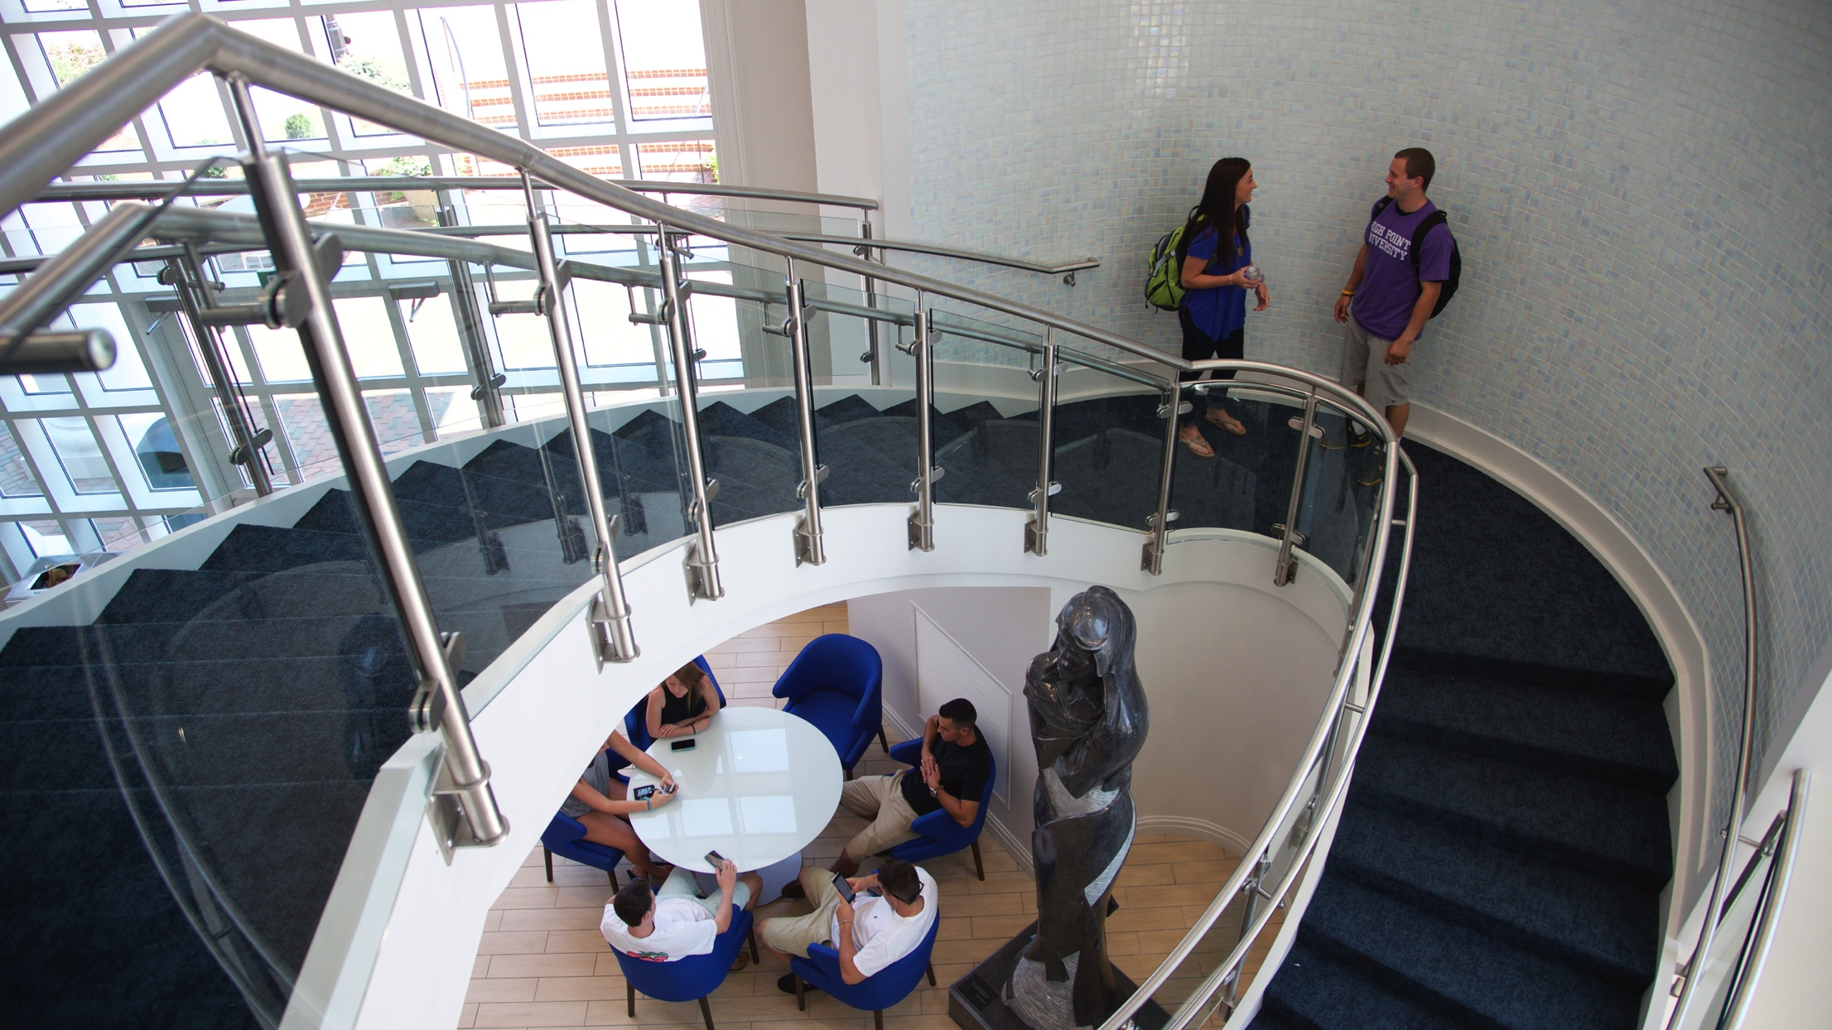
ncaa.org
twitter.com/ncaa
facebook.com/ncaastudents
NCAA is a trademark of the National Collegiate Athletic Association. All other licenses or trademarks are property of their respective holders.
Notes:
This is the final slide for every NCAA presentation. Select and use only one of the final photo slides (one of many is pictured here).
When selecting a final photo slide, ask yourself: Does the photo reflect your presentation content appropriately? For example, don’t use an athletic photo for a presentation about academic opportunities. Select a campus-based or academic image instead. Or, use the logo-only final slide included in this template.
Do not edit the content on this slide.

